Slide 1


What Factors Are Responsible for Corporate Employee Attrition?
Department of Computer Science
Group 5 | COMM053: Practical Business Analytics
Anthony Awobasivwe | Ana Paniagua Cruz | Abdulazeez Mahmud-Ajeigbe | David Asuman | Humza Malik-Ramzan | Jason Jay Dookarun

Slide 2

Overview
Identifying and Understanding Business
Data Collection,
Processing and Analysis
Data Modelling and Deployment
Results & Insights

Slide 3




Slide 4
25.2%
Attrition in the Indian IT Sector (FY22)
Source: Business Standard

Slide 5

Data Collection
Based on our hypothesis, we started investigating for datasets that would relate to the field of interest:
Kaggle
Google Database Research
DataHub.IO
UCI Machine Repository

Slide 6
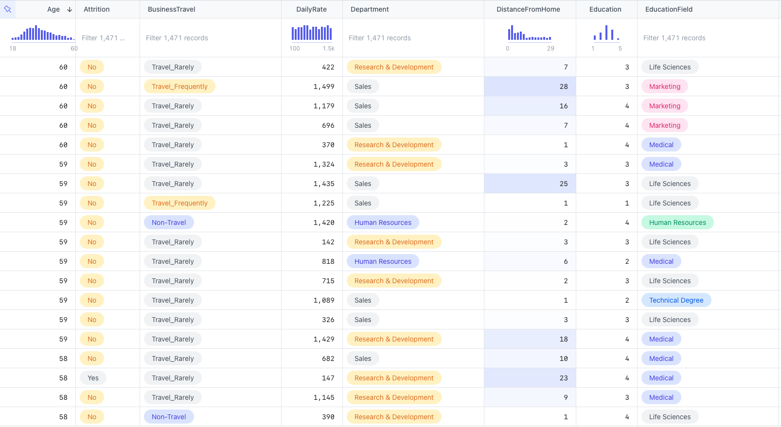

IBM
35 Features
1471 Rows

Slide 7
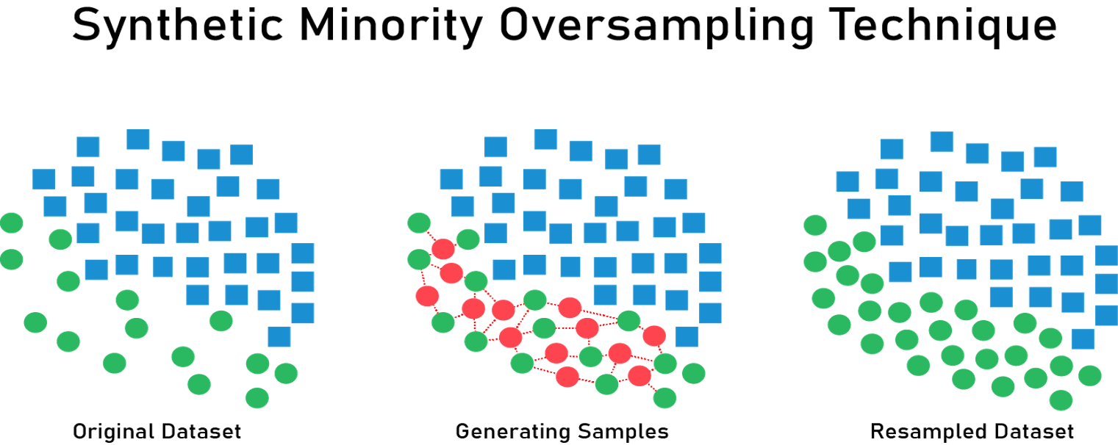
Data Pre-Processing
Outlier Checks
Factor Datatypes
Missing Data
Feature Creation and Dropping

Slide 8
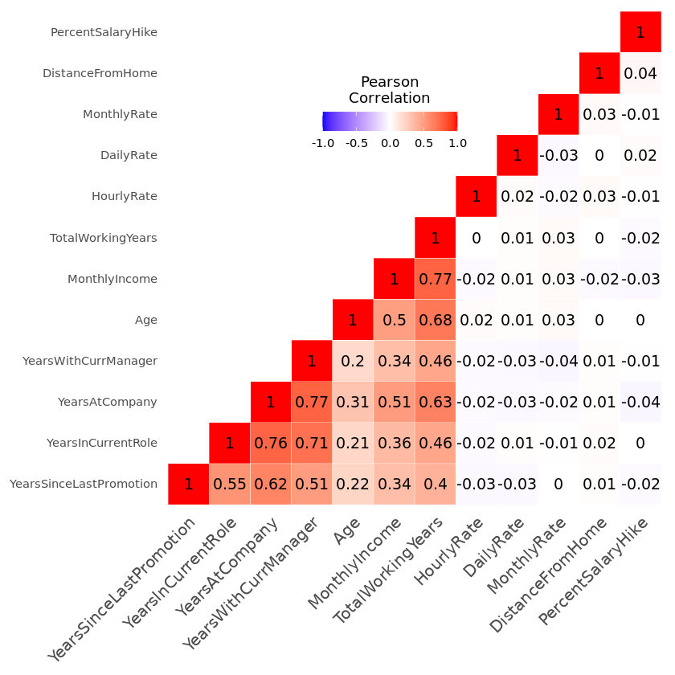
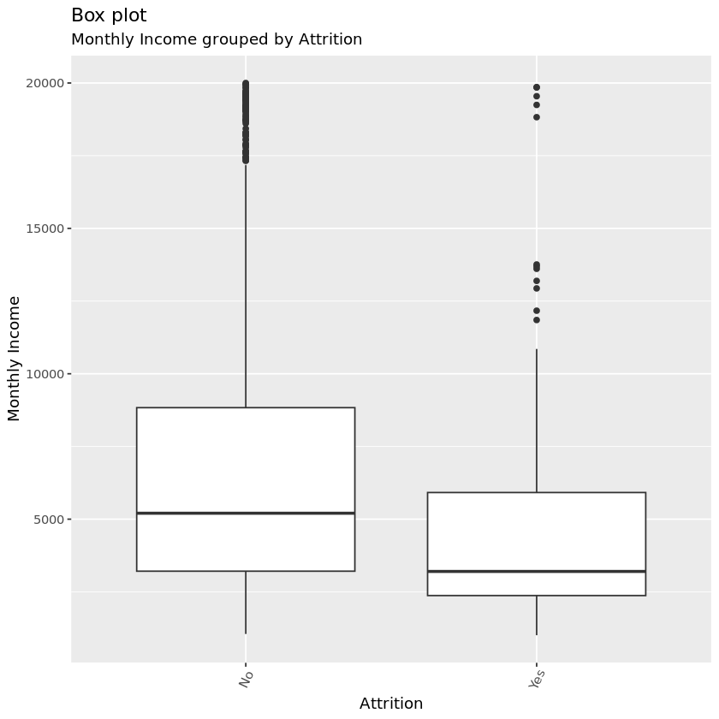

Slide 9
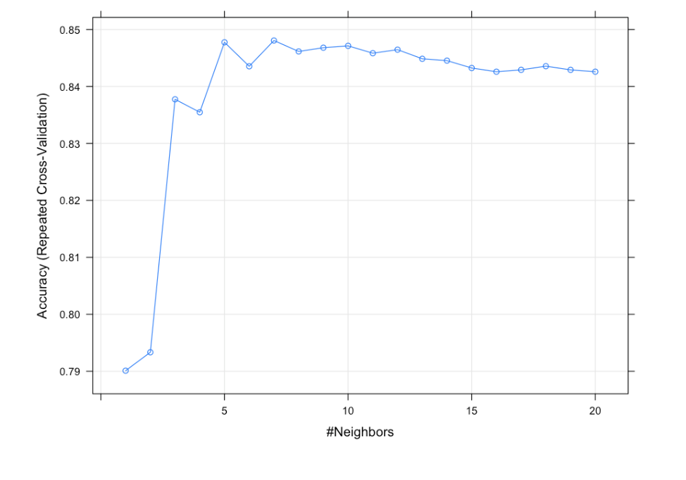
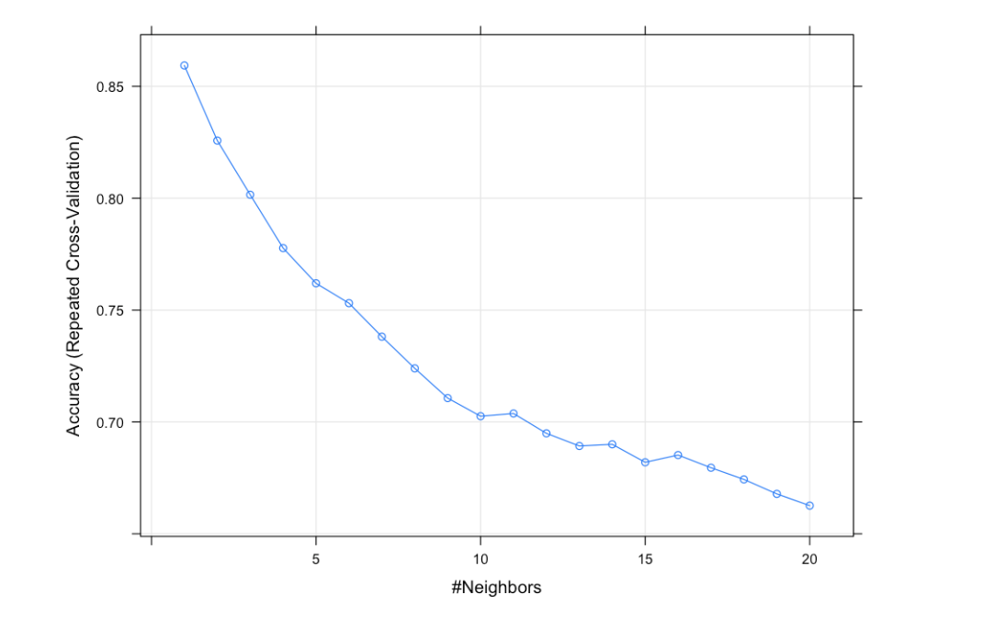
K nearest neighbour
Determining optimal k value
Accuracy Plot Base Data
Accuracy Plot Oversampled Data
Base Decision Tree

Slide 10
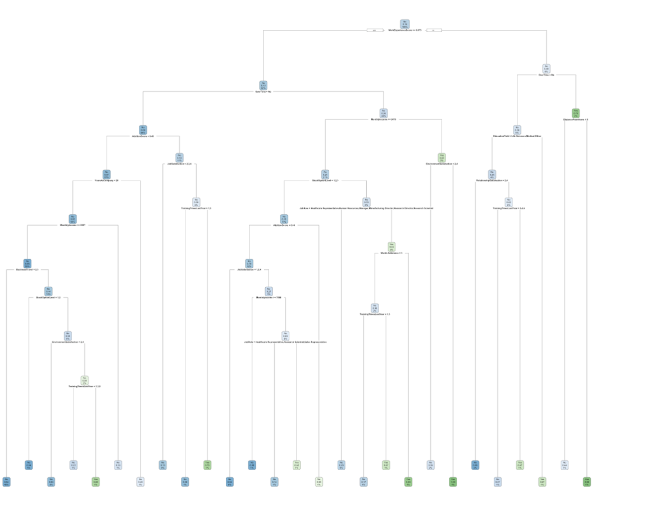
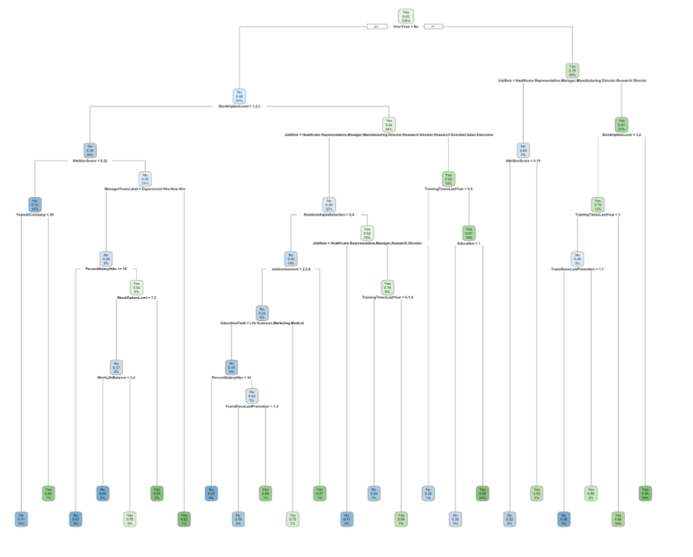
Unpruned Decision Tree
Base Data
Oversampled Data

Slide 11
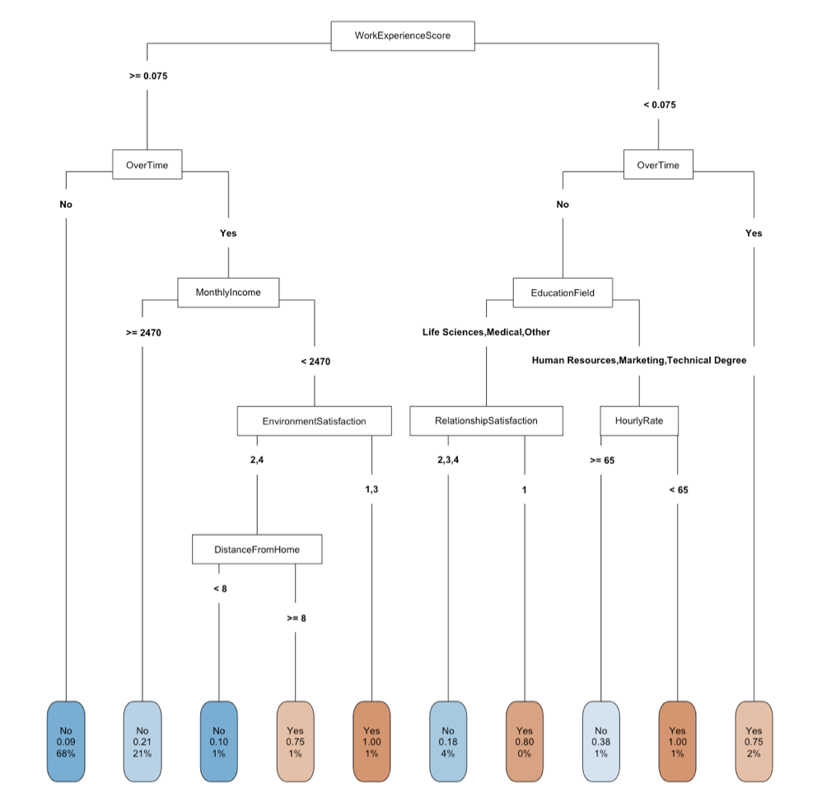
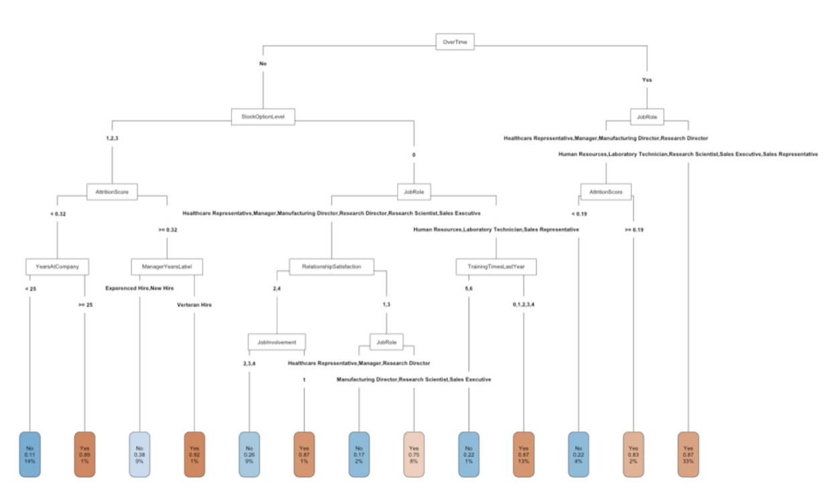
Pre Pruned Decision Tree
Base Data
Oversampled Data

Slide 12
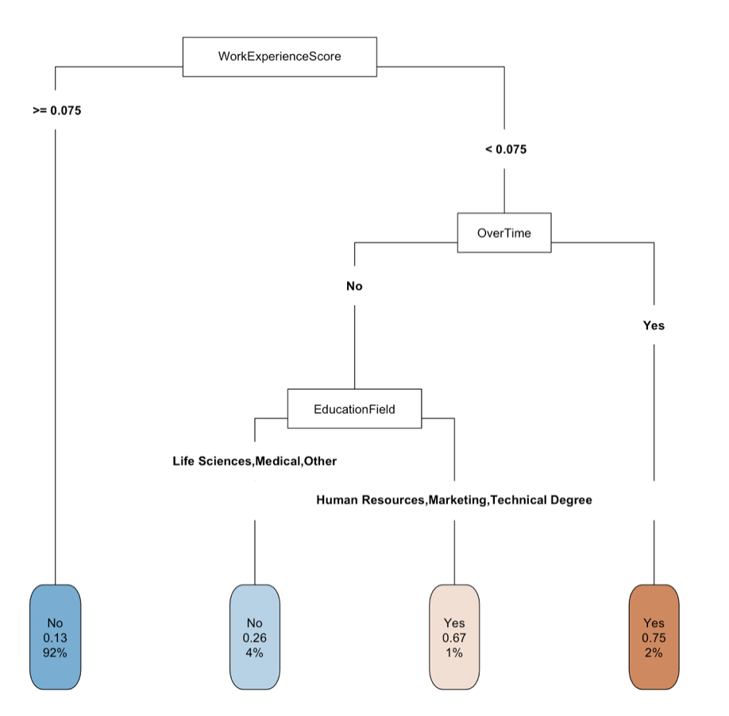
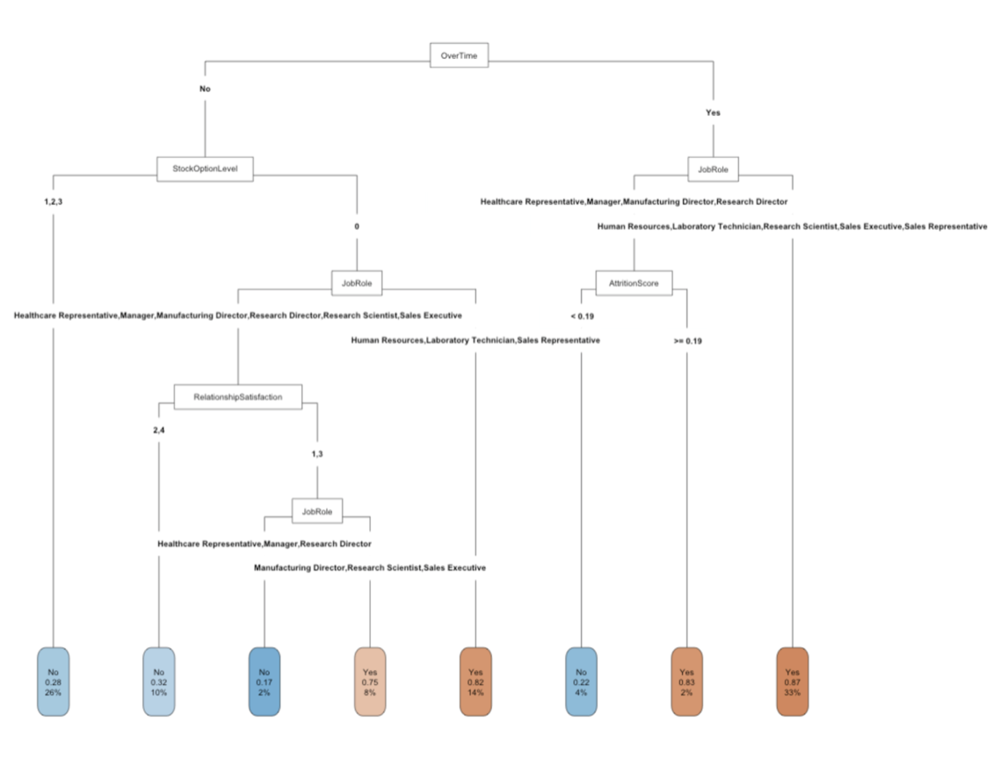
Post Prune Decision Tree
Base Data
Oversampled Data

Slide 13
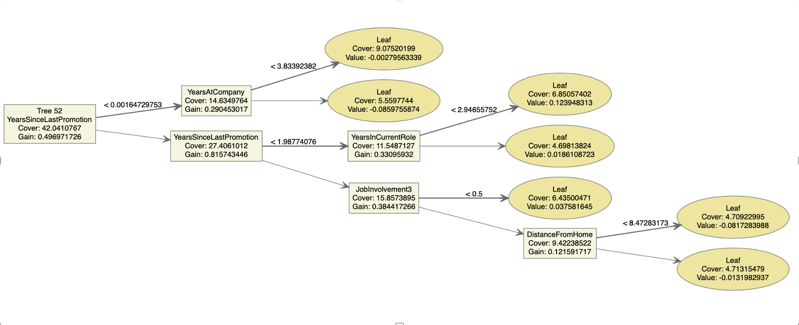
Models Used: XGBoost
Base Data Hyper-Tune XGBoost Plot

Slide 14
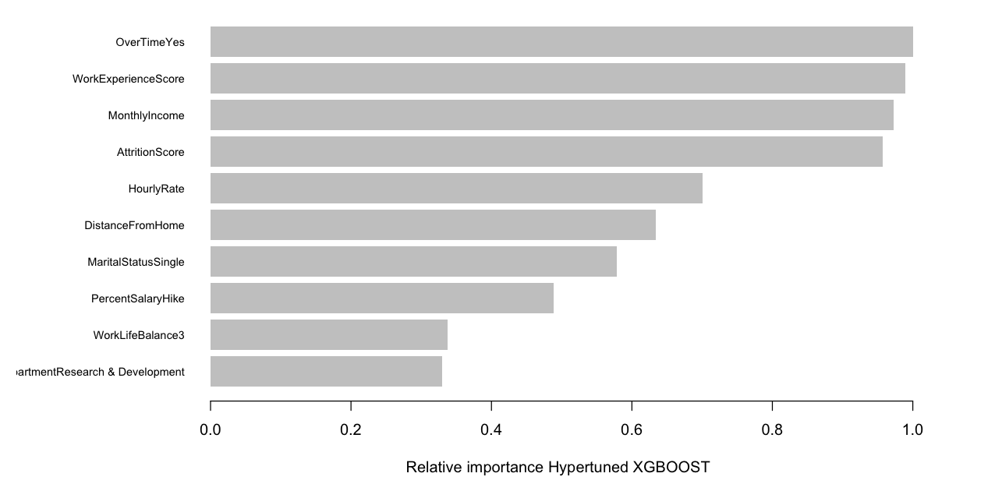
Models Used: XGBoost
Hypertuned XGBOOST Feature Importance

Slide 15
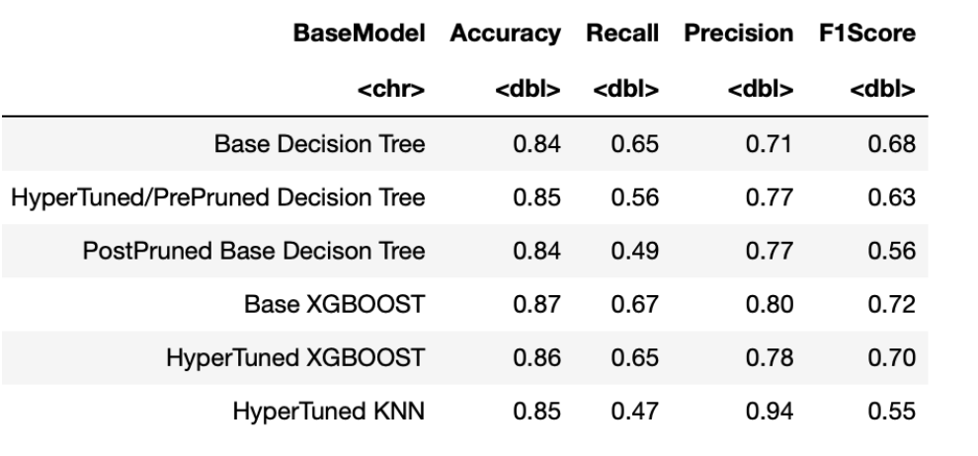
Comparison of Models Base Data

Slide 16
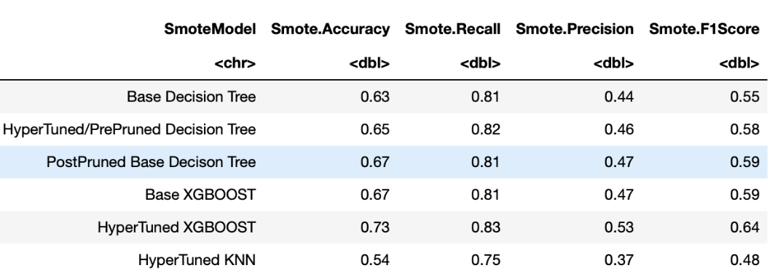
Comparison of Models Oversampled Data

Slide 17
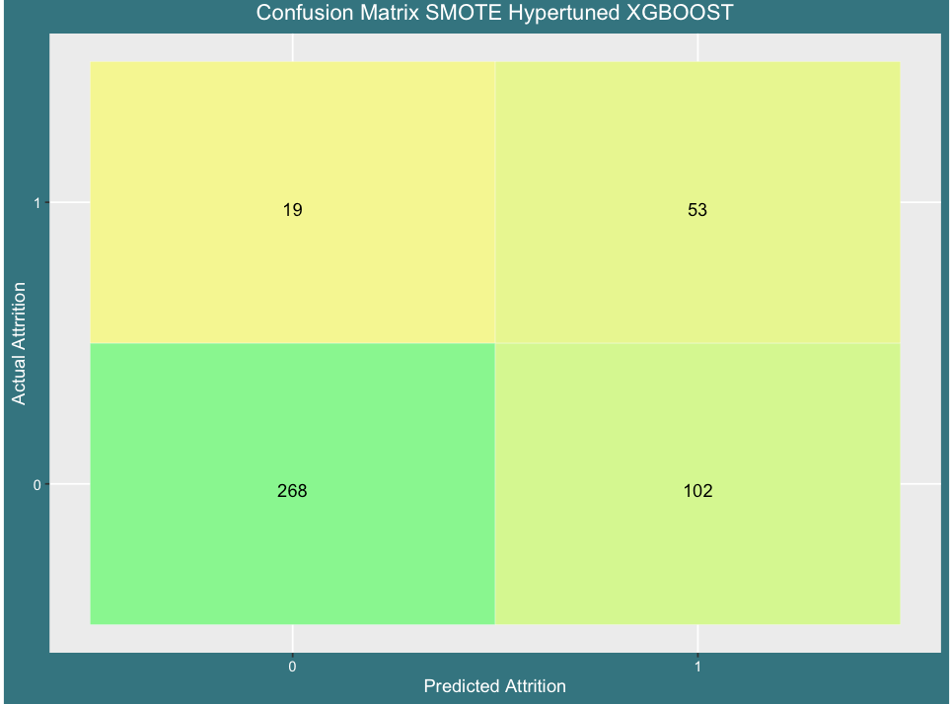
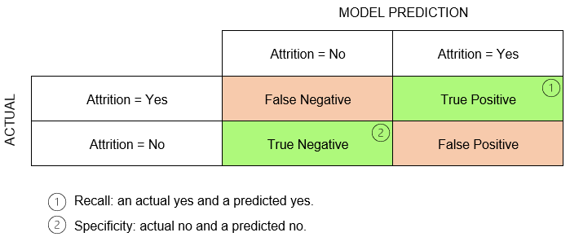
Results
93% Accuracy for those who chose to stay
74% Accuracy for those who chose to leave the company

Slide 18

Insights
'OverTime' was the most significant on attrition
Offering more employee benefits
Outliers discovered in "YearsSinceLastPromotion"

Slide 19

Future Work
PCA Investigation
\
Consideration of Multiple Data Sources
Application of Train Test Validation Splits to Avoid Leakage

